Slide 1
2. Phonological typology
ENG 452: Linguistic Typology

Slide 2
Introduction
Languages of the world can be studied from different aspects such as phonology (sound), morphology (words), syntactic (structure of words), etc.
Typology is the study of structural features across languages.
Phonological typology is a subfield of linguistics that studies the sound system across languages from a cross-linguistic perspective.
The aim is to identify and classify the diversity of phonological patterns and structures found across human languages.
In doing so, it tries to understand the underlying principles and universals that govern these patterns in languages.

Slide 3
The study of linguistic universals is concerned with what human languages have in common,
while the study of linguistic typology deals with ways in which languages differ from each
other.
In this phonological typology, we shall look at the following:
1. Phoneme inventory typology
What kinds of phoneme inventories are found? (variations in consonants and vowels in languages)
Which are common and what are uncommon?
2. Structure of Syllables
3. Phonotactic

Slide 4
1. Phoneme inventory typology

Slide 5
1.1 English Consonants and Vowel system (English Phoneme inventory)
The English Alphabet consists of 26 letters:
A, B, C, D, E, F, G, H, I, J, K, L, M, N, O, P, Q, R, S, T, U, V, W, X, Y, Z.
Despite there being just 26 letters in the writing system of English language,
there are 44 sounds, also known as phonemes.
A phoneme is a speech sound. It’s the smallest unit of sound that distinguishes one word from another. Since sound.
A grapheme is the written representation (a letter or cluster of letters) of one sound.
The 44 English sounds can be divided into two major categories – consonants and vowels

Slide 6
26 letters but 44 sounds???
There are some letters that are used to write down sounds already represented by other graphemes.
Eg. the letter C represents /k/ sound (already represented by the grapheme ‘k’) and the /s/ sound
(already represented by the grapheme ‘s’)
C has two sounds: s in city /sɪtɪ/ cent /sent/, cyst /sist/
k in cat /kæt/ cut /kʌt/, class /klɑːs/
S has two sounds: s in see /ˈsiː/
z in is /ɪz/
G has two sounds: g in get /ɡet/
j in gin /dʒɪn/
X has the sound of: ks box (bɒks), fox (fɒks, fix (fiks)
gs /gz /z at other times /ɪɡˈzak(t)li/ , /ɪɡˈzæmpəɫ/ ɪgzám /ˈzaɪ.lə.fəʊn/
exactly, example, exam xylophone
Q is written: kw as queen /kwiːn/

Slide 7
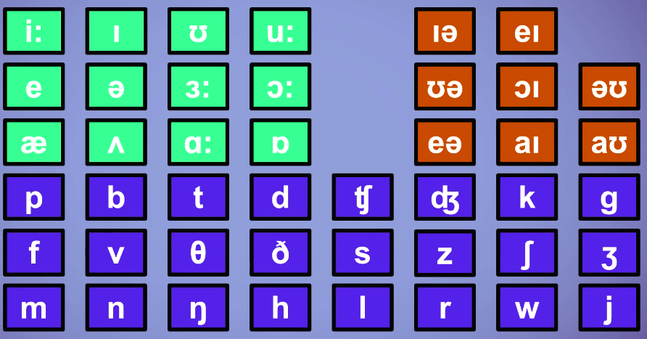
The 44 phonemes in English
Source: Screenshot from
https://www.youtube.com/watch?v=h4yrIuCE6UM&list=RDCMUCdBJyql_ZEzTfPjLB-mFQNg&index=26

Slide 8
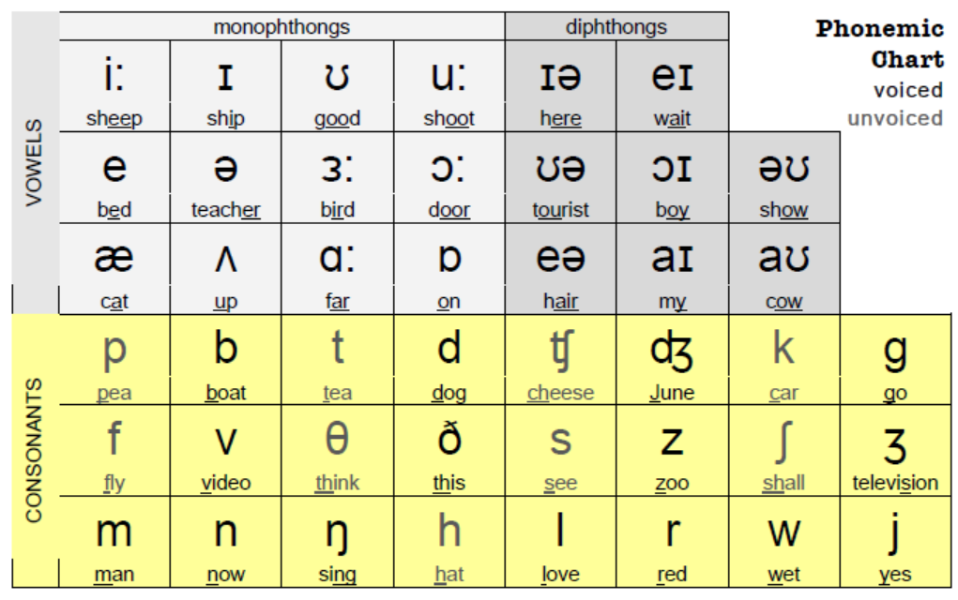
https://www.englishclub.com/esl-handouts/EC_phonemic-chart.pdf

Slide 9
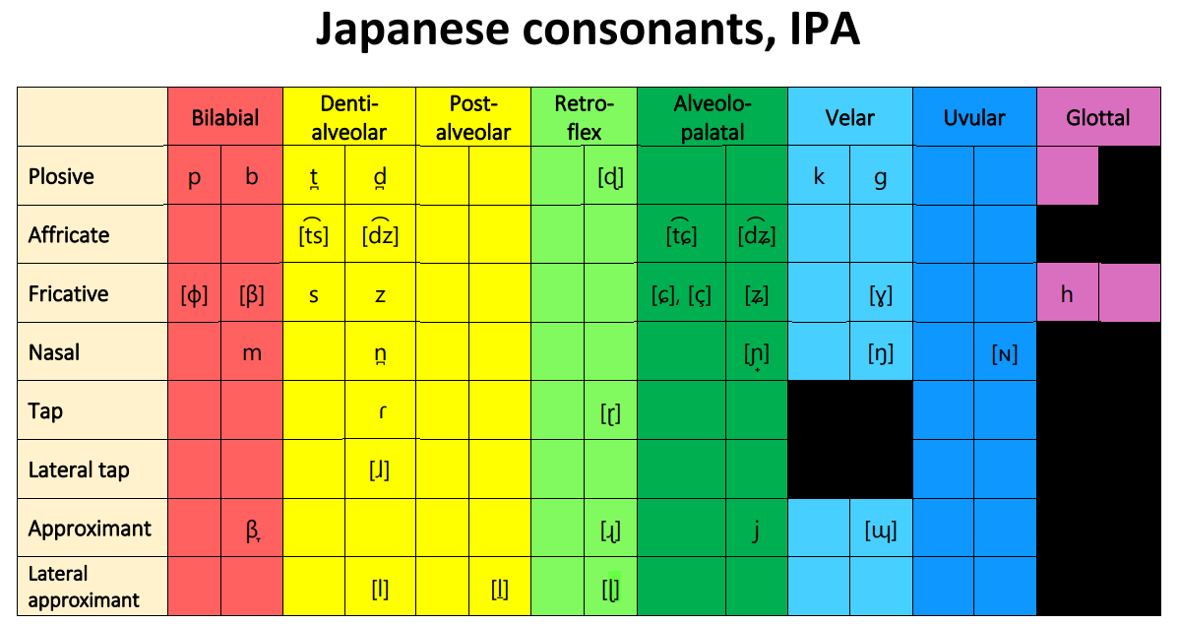
1.2 Japanese Consonants and Vowel system (Phoneme inventory)

Slide 10
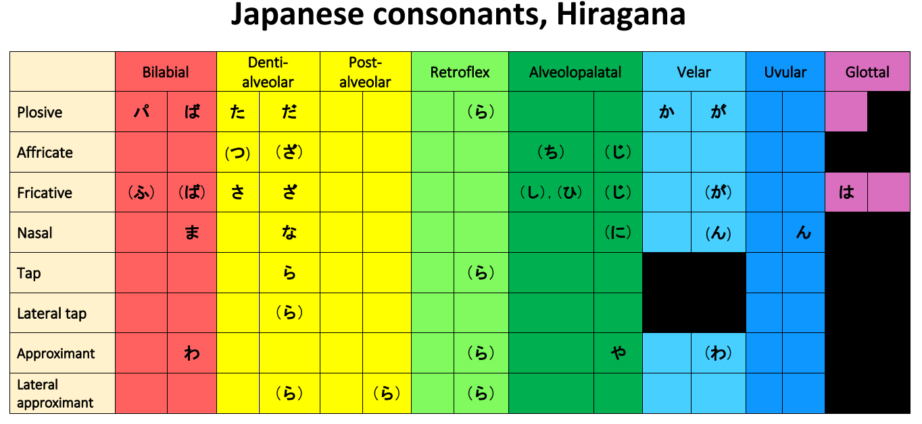

Slide 11
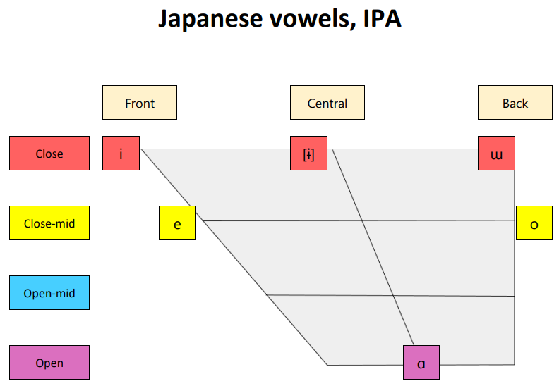

Slide 12
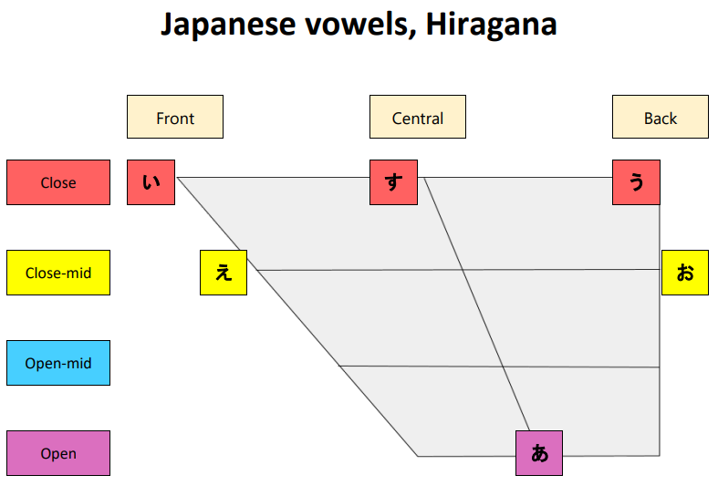
https://ielp.ehe.osu.edu/files/2022/08/Japanese_IPA.pdf

Slide 13
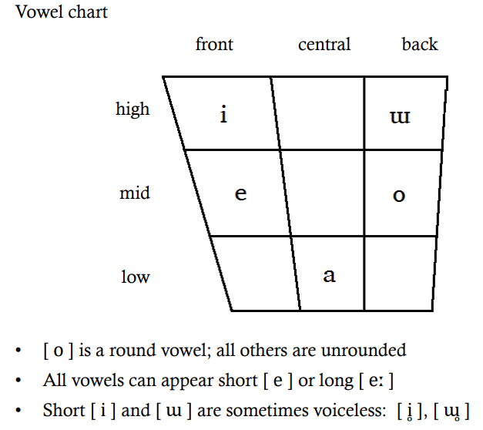
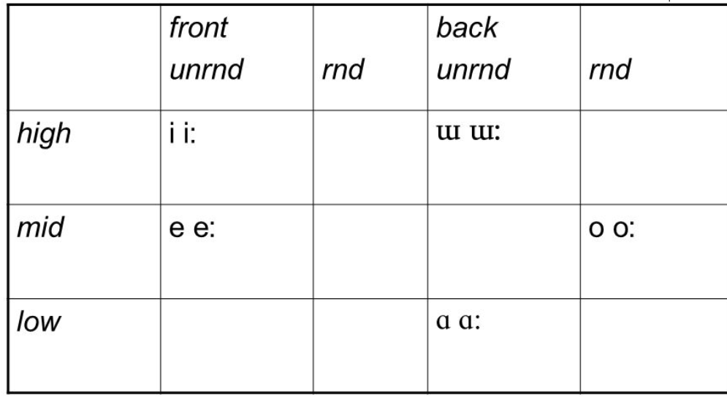
Japanese vowel has long vowel counterpart
https://users.castle.unc.edu/~jlsmith/ling563/handouts/07_phonetics_ref_charts.pdf

Slide 14
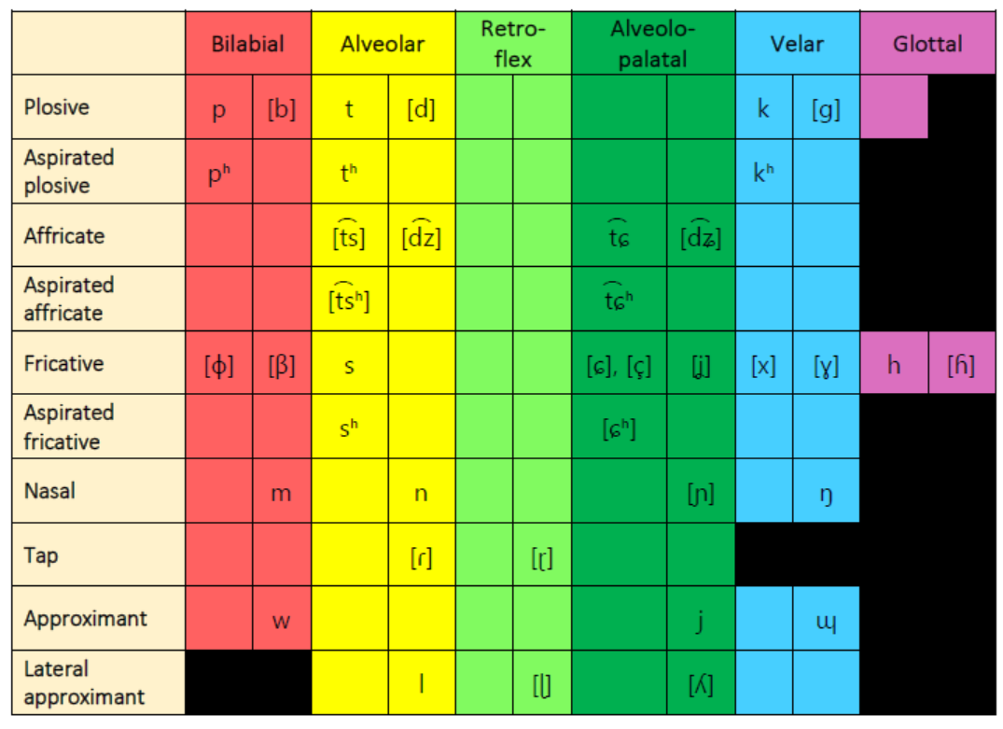
1.3 Korean Consonants and Vowel system (Phoneme inventory)
Korean consonant chart
https://ielp.ehe.osu.edu/files/2022/08/Korean_IPA.pdf

Slide 15
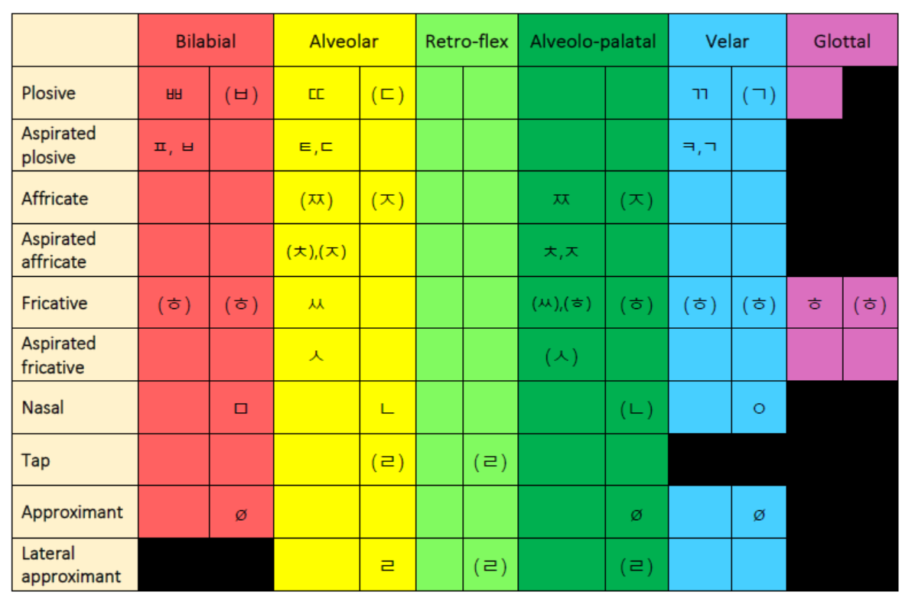
Korean script chart

Slide 16
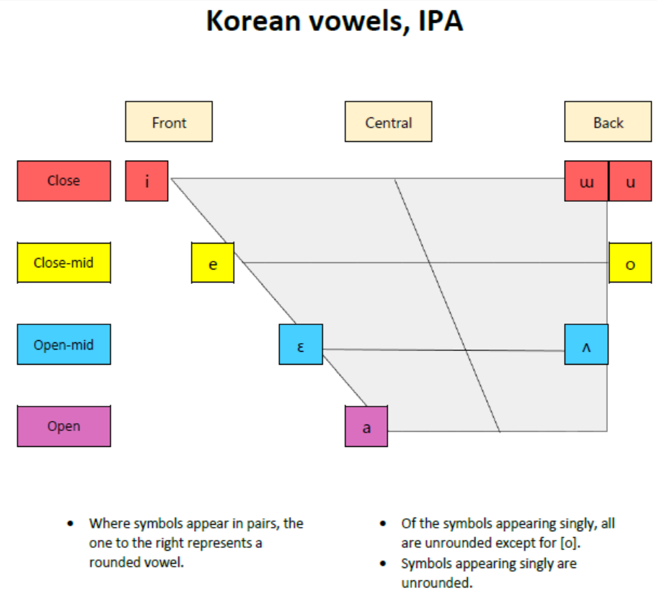
Here

Slide 17
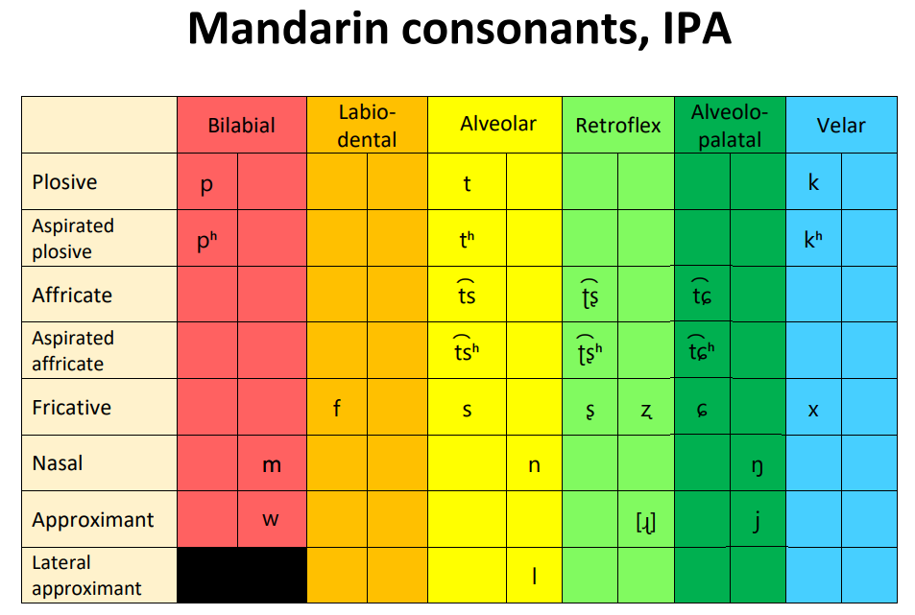
1.4 Mandarin Chinese Consonants and Vowel system (Phoneme inventory)
https://ielp.ehe.osu.edu/files/2022/09/Mandarin_IPA_20220830.pdf

Slide 18
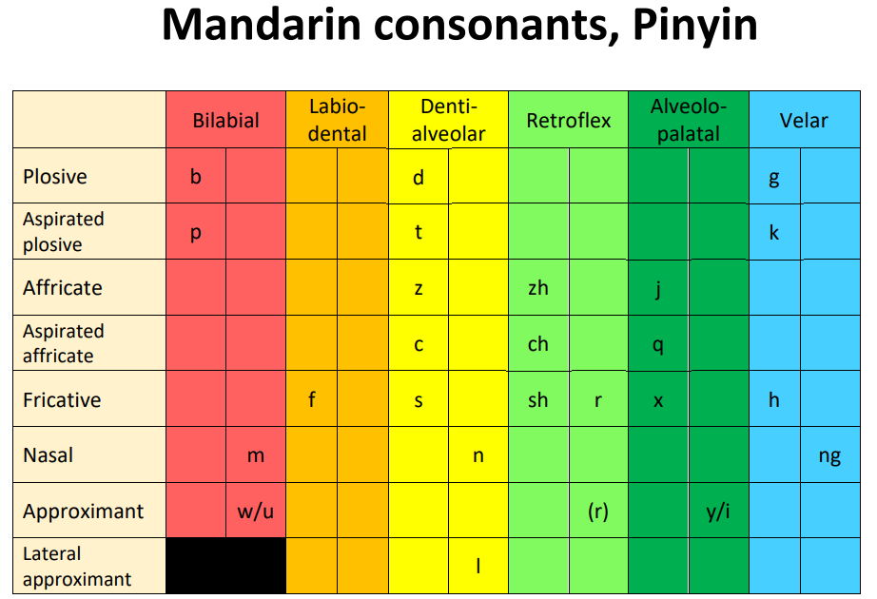

Slide 19
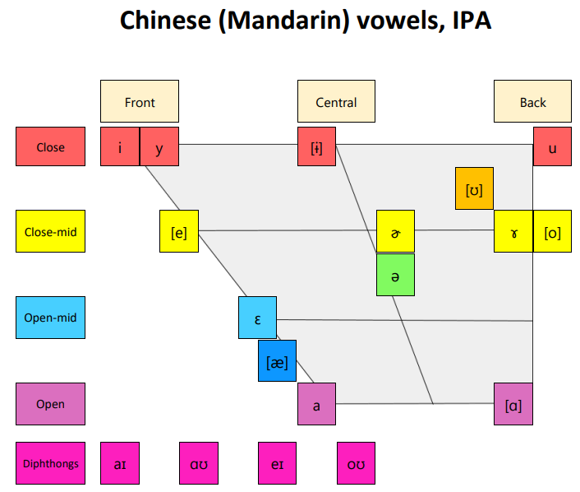

Slide 20
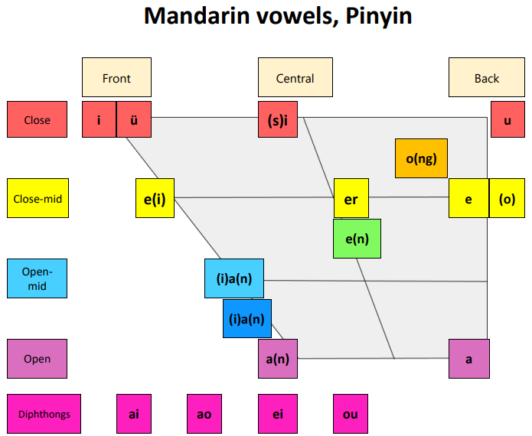

Slide 21
1.5 Hindi Consonants and Vowel system (Phoneme inventory)
The Hindi alphabet is the foundation of the Hindi language, mainly spoken in India.
It uses the Devanagari script, also used for other Indian languages.
It consists of vowels “स्वर” (swara) and consonants “व्यंजन” (Vaynjan), like the English alphabet.
Vowels in Hindi are crucial for pronunciation.
The standard Hindi alphabet has 11 vowels and 35 consonants, as agreed by the Government of India.
However, traditionally the Hindi alphabet has 13 vowels and 33 consonants. There are also 4 combined consonants and 2 binary consonants. In total 52 alphabets in Hindi

Slide 22
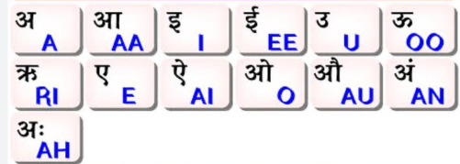
There are 52 total alphabets in Hindi on writing basis in which 13 vowels and 39 consonants.
13 vowels

Slide 23
There are 39 letters for Hindi consonants are given below:
33 Consonants –
क [k] ख [kha] ग [g] घ [gha] ङ [nga]
च [ca] छ [chha] ज [ja] झ [jha] ञ [nya]
ट [ta] ठ [thh] ड [da] ढ [dh] ण [n]
त [t] थ [tha] द [d] ध [dha] न [na]
प [p] फ [pha] ब [b] भ [bha] म [ma]
य [ya] र [ra] ल [la] व [va] श [sha]
ष [shha] स [sa] ह [ha] क्ष (ksha), त्र (tra), ज्ञ (gya), श्र (shra)
4 Combined consonants – क्ष (ksha), त्र (tra), ज्ञ (gya), श्र (shra)
2 Binary consonant – ड़ (ra) ढ़. (rha)
Total = 33 (Consonants) + 4 (Combined consonants) + 2 (Binary consonant) = 39 Consonants.

Slide 24
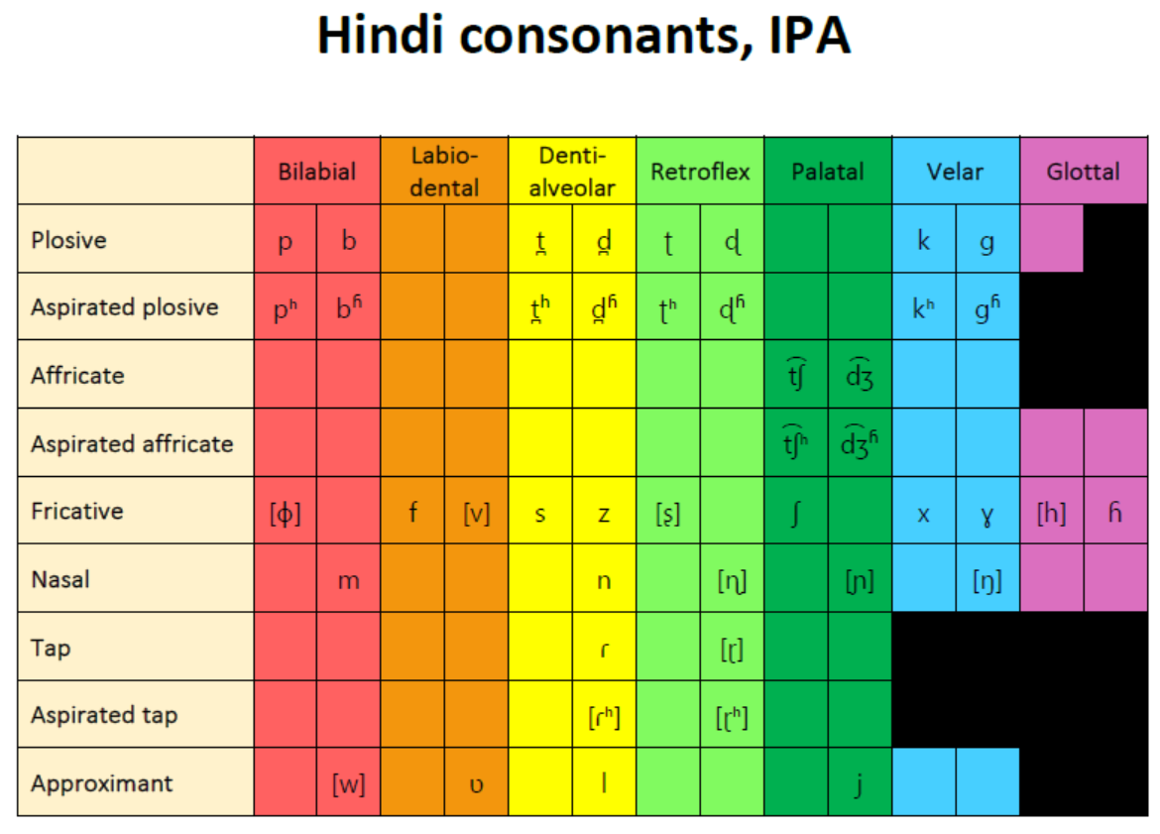
https://ielp.ehe.osu.edu/files/2022/08/Hindi_IPA.pdf

Slide 25
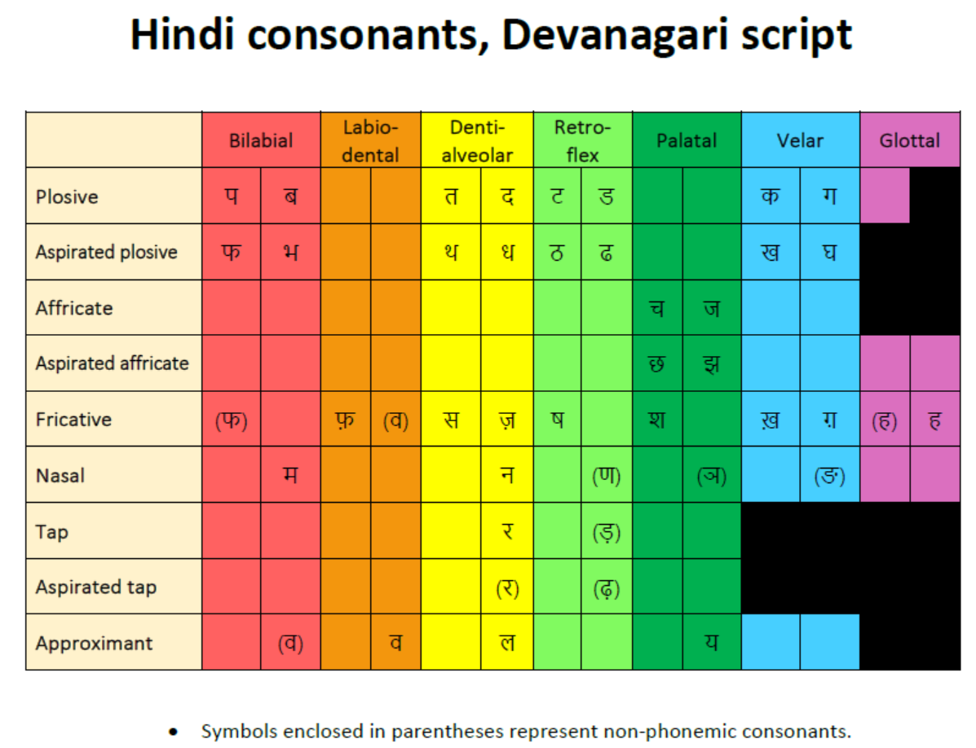

Slide 26
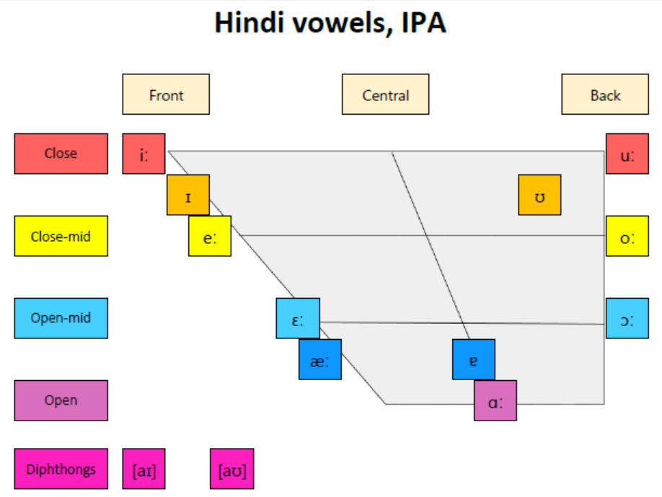

Slide 27
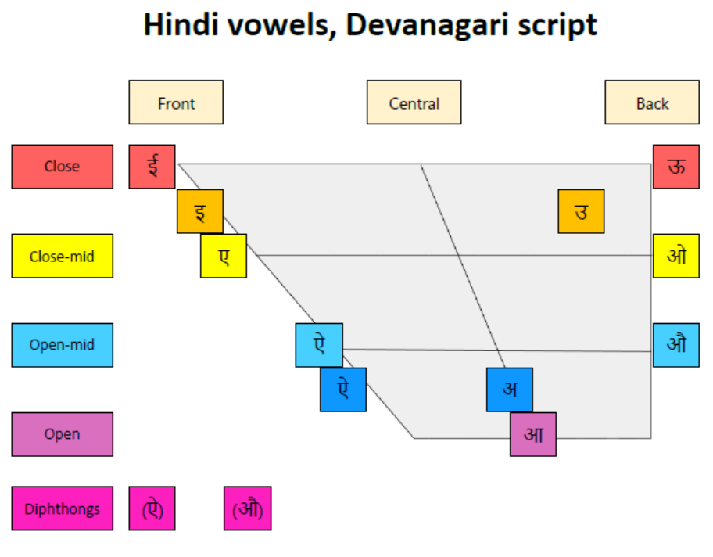

Slide 28
1.6 Summing up the phonemic inventory typology
A look into the IPA (International Phonetic Alphabet) reveals great diversity in the types of sounds found in languages of the world.
Sounds are differentiated along various dimensions such as
- the place of articulation, the manner of articulation, and voicing (for consonants),
- front, central, back or
high, mid-high,
mid-low, low,
rounded or unrounded (for vowels)

Slide 29
1.6.1 Comparing the consonants and vowels inventory in the languages, we see
All languages have speech sounds used for communication.
The speech sounds are different in every language
The speech sounds consist of consonants and vowels
The number of consonants and vowels are not the same in all languages
The number of vowels can vary considerably.
Some has more number of consonants
Some has more number of vowels
Some has unique consonants and vowels inventory
While some consonants and vowels are same, there are also lots of differences.
Eg. Some consonants and vowels found in English are NOT found in Hindi, Japanese, Chinese, etc.
And vice versa.
Some language also have their own script.

Slide 30
Comparing the vowels, we can observe that
Some common vowels are:
High front unrounded vowel /i/
Open/Low unrounded vowel /a/ and
High back rounded vowel /u/
Whereas there is variation in other vowels in languages
Some languages may have only phonemes, while some may have allophones

Slide 31
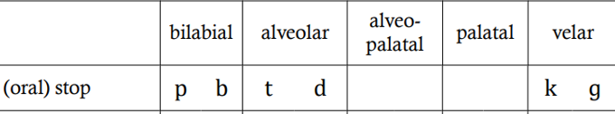
Comparing the Consonants, we can observe that
Some common consonant are:
Voiceless plosives /p/, /t/, /k/
Every language will have at least one of these voiceless plosives as a phoneme.
Fricatives /f/, /v/
Nasal sounds /m/, /n/, /ŋ/ (every language will have at least one nasal sound /m/ or /n/)
While some languages have consonants which are not found in other languages,
Eg. retroflexes /ʈ/, /ʈh/, /ɖ/, and /ɖh/ in Hindi), NOT found in English and Japanese
No language will have voice plosive without voiceless plosive
it means to say, if they

Slide 32
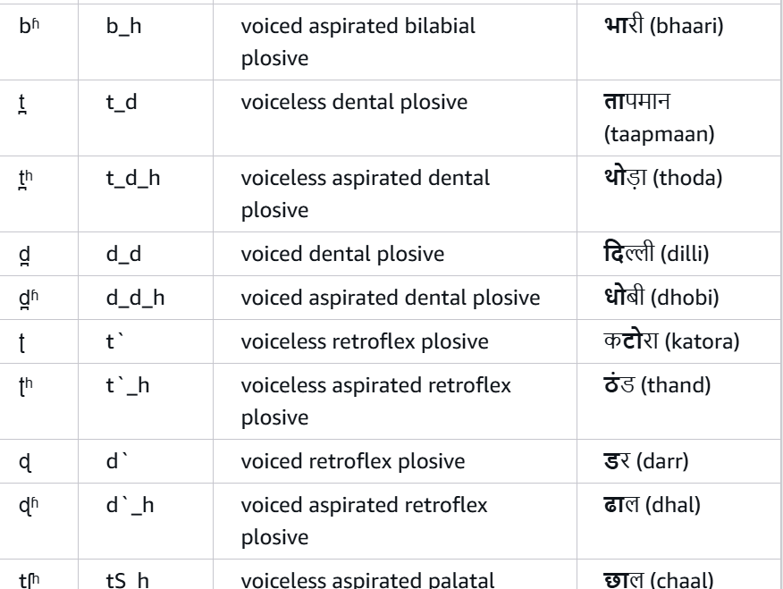
Some languages have unique speech sounds
For example, Hindi
https://docs.aws.amazon.com/polly/latest/dg/ph-table-hindi.html

Slide 33
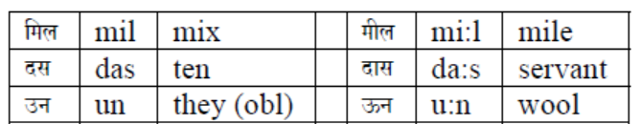
Another interesting difference we observe in Hindi different from English (keeping aside other languages)
Both Vowel length and Aspiration are phonemic in Hindi
Vowel length
Length is phonemic in Hindi.
There are three pairs of short and long vowels: /i/ and /i:/; /a/ and /a:/; /u/ and /u:/.
The following minimal pairs illustrate the contrast in the length of these vowels.

Slide 34
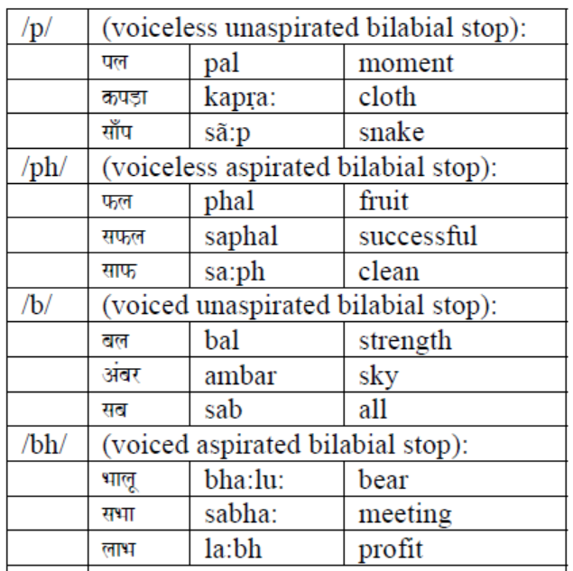
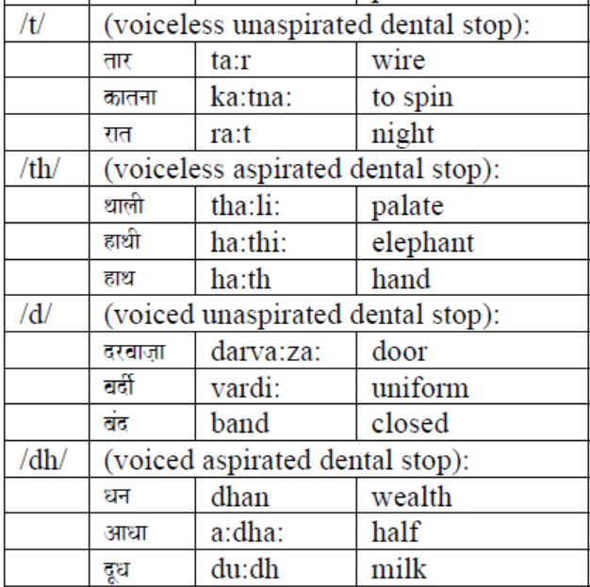
Aspiration

Slide 35
Maddieson’s Patterns of Sounds (1984) also provides some phonological variations (typology)
Maddieson’s Patterns of Sounds (1984) also surveyed phoneme inventories in 317 languages and reveals a wide range in the number of phonemes found in languages of the world from a low of 11 in the East Papuan language Rotokas (six consonants and five vowels) and in the Mura language Pirahã (eight consonants and three vowels) to a high of 141 in the Khoisan language !Xũ.

Slide 36
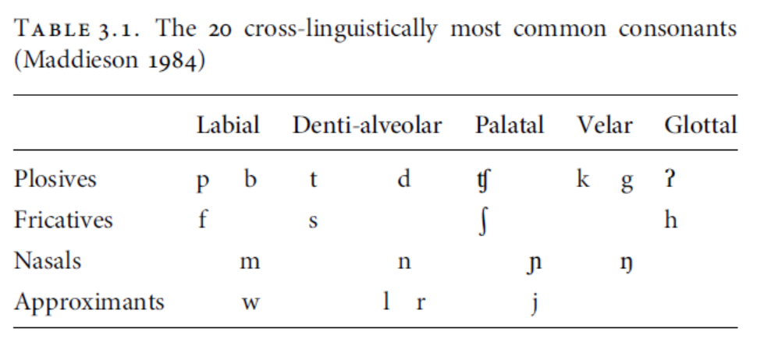
Results on Consonants typology (Maddieson’s Patterns of Sounds, 1984)
The 20 most common consonants according to Maddieson’s (1964) survey of 317 languages are below, which conflates the dental vs. alveolar distinction into a “denti-alveolar” category since it is often difficult to discern from sources whether a sound is dental or alveolar or a combination of both.

Slide 37
The modal number of consonants in an inventory is 21 (Maddieson 1984).
No languages with 21 consonants in Maddieson’s (1984) survey, however, possess all 20 of the consonants in Table 3.1.
The Mandé language Bambara (West Africa) comes closest with 19, lacking only glottal stop.

Slide 38
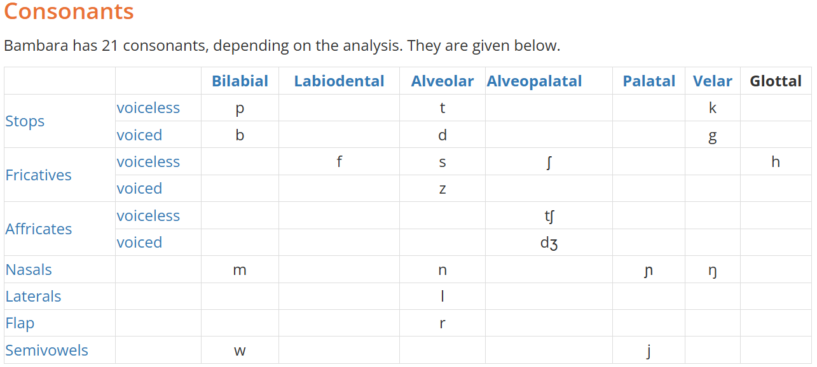
https://www.mustgo.com/worldlanguages/bambara-bamanankan/

Slide 39
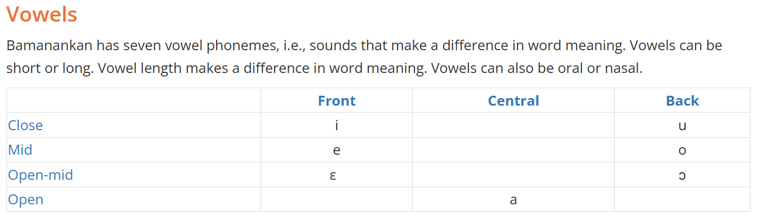
https://en.wikipedia.org/wiki/Bambara_language#:~:text=%DF%93%20%E2%80%93%20ba%20%E2%80%93%20%5Bb%5D,%E2%80%93%20nasal%20vowel%20%E2%80%93%20%5B%2D%CC%83%5D

Slide 40
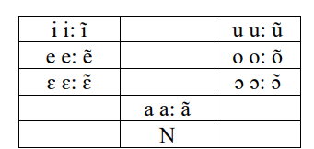
Long and short vowels are contrastive only in the initial syllable of a disyllabic foot:
sére ‘frequent pregnancies’ vs. sé:re ‘witness’,
bára ‘dancing ground’ vs. bá:ra ‘work’.
In monosyllabic feet, phonetically long vowels can appear as a result of elision of an intervocalic consonant (most often, a velar consonant; occasionally, others):
dàga ~ dàa ‘pot’,
fàga ~ fàa ‘kill’,
kɔ̀ro ~ kɔ̀ ɔ ‘elder’.
They are interpreted as combinations of two short vowels (rather than as long vocalic phonemes):
dà.a, fà.a, kɔ̀.ɔ
https://thot.huma-num.fr/wp-content/uploads/2024/10/bamb1269-bambara-vydrin.pdf

Slide 41
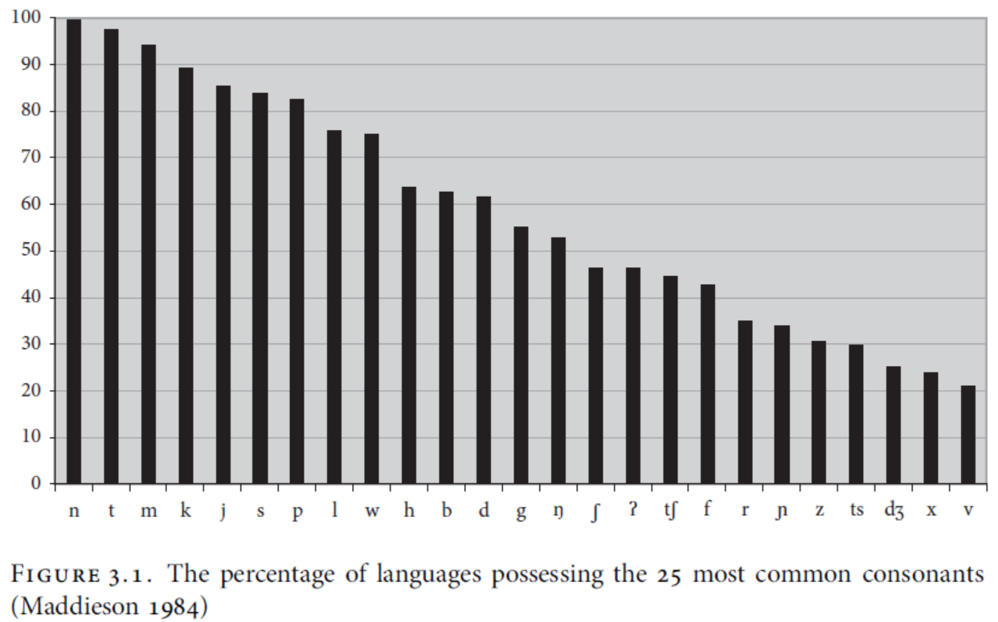
The percentage of languages (out of 317 total) in Maddieson (1984) possessing the 20 most common consonants plus the next five most frequent consonants is plotted in below (Figure 3.1.)

Slide 42
Plosives
is most common for languages to contrast unaffricated oral stops (i.e. stops other than glottal stop) at three places of articulation (bilabial, denti-alveolar, and velar) adding a fourth place (typically palato-alveolar) if affricates are included.
Fricatives
The preference for voiceless fricatives over their voiced counterparts is considerably greater.
Nasals
In contrast to fricatives and plosives, both of which are biased toward voicelessness, the vast majority of the world’s nasals are voiced. All 317 of the languages in Maddieson’s (1984) survey that possess nasal consonants have one or more voiced nasals.

Slide 43
Liquids
Most languages have one (23.3%), two (41.0%), or three (14.5%) liquids (laterals and rhotics), with laterals being slightly more common (found in 81.4 % of languages) than rhotics, i.e. r-like sounds (found in 76.0 % of languages).
Non-liquid approximants (glides)
Most languages (86.1%) in Maddieson’s (1984) survey have a palatal glide /j/ and a large percentage (75.7%) have a labio-velar glide (semi-vowel w, j).

Slide 44
Place of articulation
The Greater than symbol > means is more common than
– labial, alveolar, velar > alveopalatal > uvular, dental, retroflex > pharyngeal
Most languages have one laryngeal consonant
– /h/ > /ʔ/ > /ɦ/

Slide 45
Manner of articulation
Stops > fricatives, nasals
Most languages have at least one fricative
Most languages have one liquid
Most languages have glides /w j/
–but in some languages, /w j/ do not contrast with high vowels
Nasals
Most languages have at least one nasal, either m, n,

Slide 46
Phonation contrasts
Obstruents
Stops
voiceless (aspirated) only > voiceless vs. voiced > voiceless vs. aspirated
Fricatives
• voiceless > voiced
•Sonorants: laryngeal contrasts rare

Slide 47
Results on Vowels typology (Maddieson’s Patterns of Sounds, 1984)
The number of phonemic vowel qualities per language in Maddieson’s (1984) survey is plotted in Figure 3.5. Although there are languages with as many as 15 contrastive vowel qualities, the vast majority of languages have between five and seven (64.7%) vowel qualities with the modal number being five (30.9%).
The three most common vowels are the three corner ones:
/i/ (found in 91.5% of languages),
/a/ (80.0%), and
/u/ (83.9%).

Slide 48
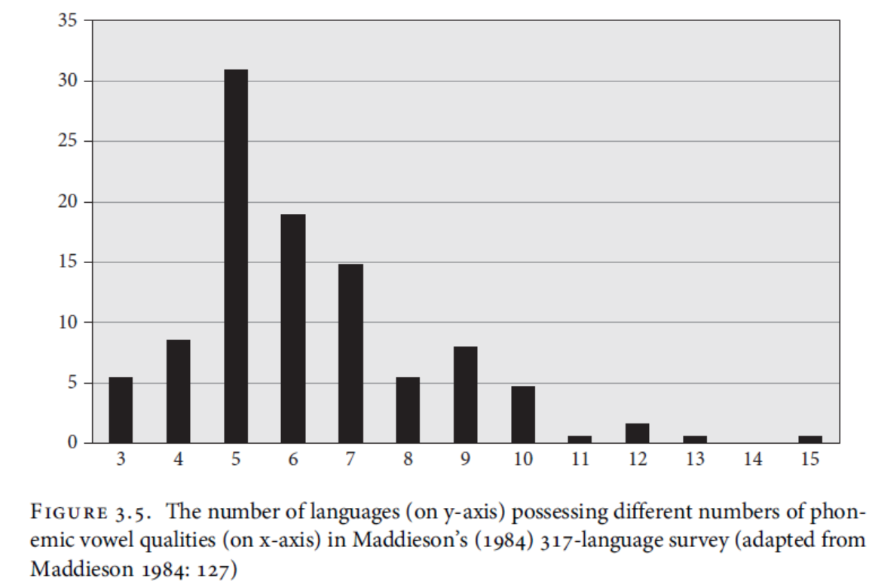
Here

Slide 49
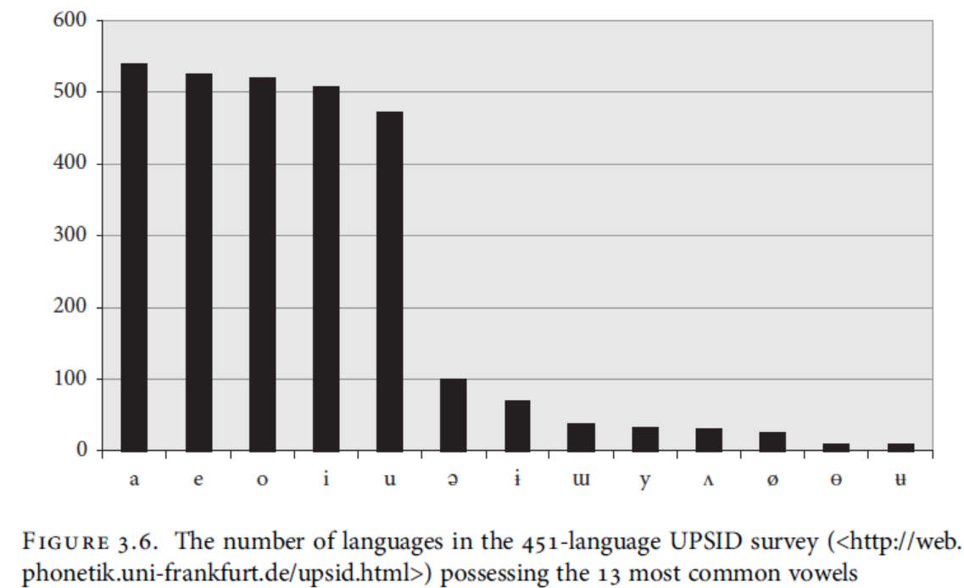
Here

Slide 50
The five most common vowels are /a, e, o, i, u/.
front rounded vowels > (more common than) back unrounded vowels

Slide 51
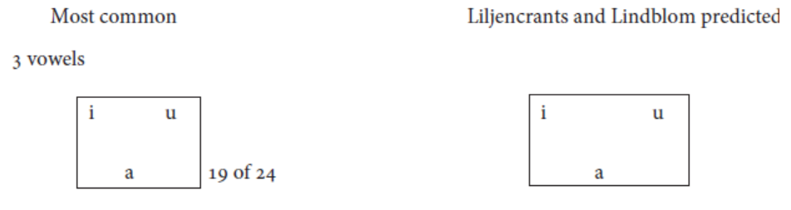
Most common vowel inventories
Most common vowel inventories of different sizes compared with those of the same size predicted to occur by Liljencrats and Lindblom (1972)

Slide 52
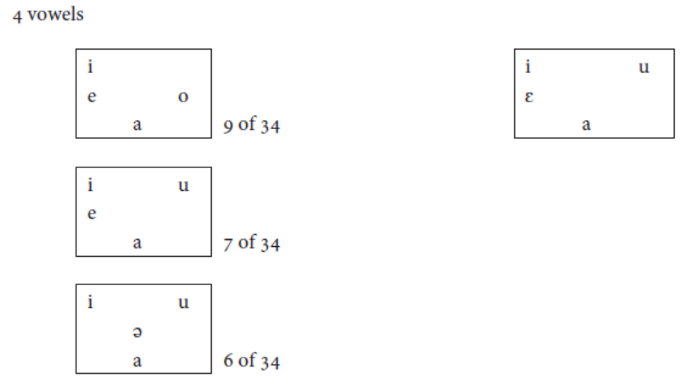
Here

Slide 53
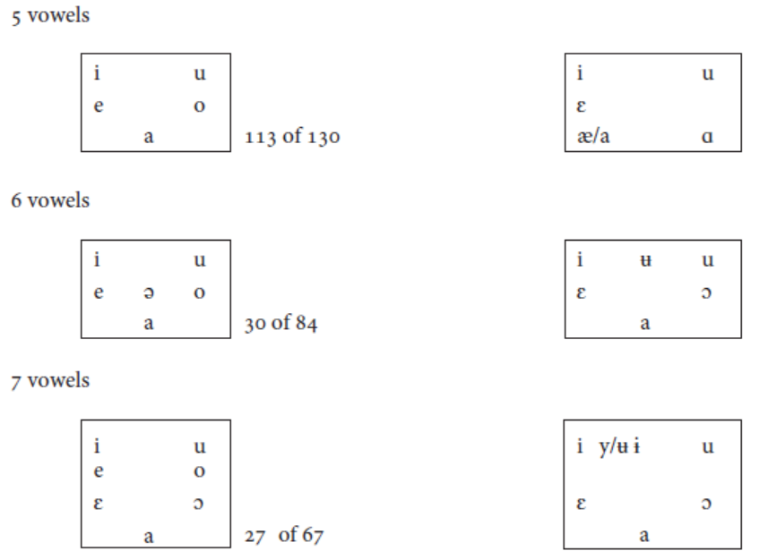
Here
Gordon, Matthew K. (2016). Phonological Typology. Oxford University Press.

Slide 54
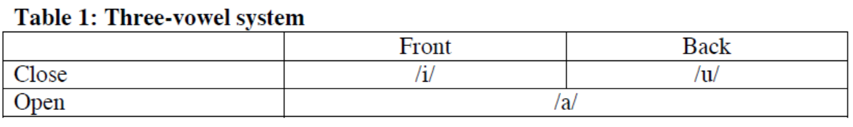
No language is known for sure to have less than three vowel phonemes.
In languages with only three vowel phonemes, like Moroccan Arabic, these are always one close front vowel, one close back vowel and one one vowel:
All languages make a distinction between close and open vowels.
All languages make a distinction between front and back vowels.

Slide 55
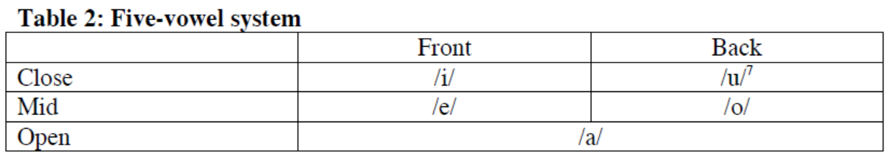
The most common five-vowel system (found in languages like Swahili, Spanish and Japanese) distinguishes front and back in the close and mid vowels, but again not in the open:

Slide 56
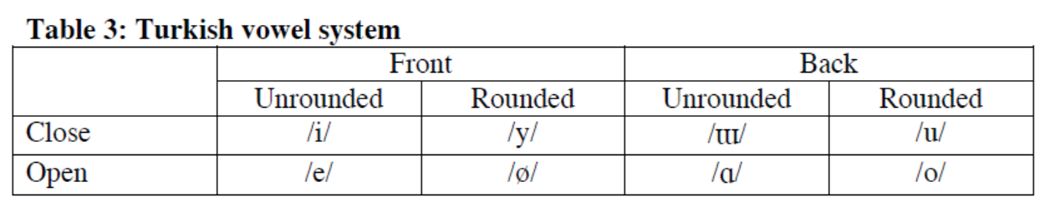
Some languages have unrounded and rounded vowels.
Eg. Turkish has the same number of close and open vowel phonemes:
Note that in this system, /e/ and /o/ are open rather than mid. This does not necessarily mean that they are pronounced differently from /e/ and /o/ in languages where they count as mid vowels, only that they fill different slots in the system.
https://www.uio.no/studier/emner/hf/ikos/EXFAC03-AAS/h05/larestoff/linguistics/Chapter%203.(H05).pdf

Slide 57
Syllabic Consonant
It is well known that a syllable must contain a vowel sound.
However, in some syllables, no vowel sound is found.
Eg.- Table-/teɪ.bl/
There are two syllables in this word. The second syllable does not have a vowel in it. Here the consonant /l/ acts as a vowel sound. In such cases the consonants acting as vowels are called as syllabic consonants.
Not all the consonants can be syllabic consonants.
Only the consonants /l/, /m/and /n/ can at times become syllabic consonants, that is, they can form syllables without the help of vowel sounds.
Ex: Brittle /brɪ.tl/, Subtle- /sʌ.tl/
Rhythm /rɪ.ðm/, prism- /prɪ.zm/
Sudden /sʌ.dn/, Mutton- /mʌ.tn/
Hindi does not have Syllabic Consonant ???

Slide 58
Syllable Structure
First, what is a syllable?
A syllable is a unit of speech sound (pronunciation) in a word that usually has one vowel sound, and may also have consonants sounds around it. (meaning to say, the vowel may be preceded and/or followed by a consonant (C) or a cluster of consonants (CC or CCC).
A syllable is one or more speech sounds that are pronounced together in one breath pulse.
A syllable may be one sound or a group of sounds which forms either a complete word having a meaning (e.g. pen), or a part of a word (e.g. pen.cil).
A syllable is a group of one or more sounds.
The essential part of a syllable is a vowel sound (V).
A syllable can be a complete word or a part of word with one vowel sound.
For example, the word water is composed of two syllables: wa and ter as we have to make two efforts to pronounce this word.
Cat has only one syllable
Banana has three syllalbes

Slide 59
Components of Syllable Structure
Syllable structure is the organization of speech sounds into syllables.
A syllable has three parts. They are onset, nucleus, and coda.
The onset and the coda are consonants, or consonant clusters, that appear at the beginning and the end of the syllable respectively.
The nucleus forms the core of the syllable; it is most often a vowel, or a combination of vowels - but there are exceptions to that in languages that have syllabic consonants.

Slide 60
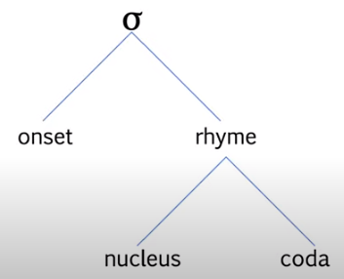
Spoken words are made up of syllables, and these syllables also have internal structure.
The syllable structure is shown below: The symbol for syllable is σ .
In the word “cat” for example, [c] is the syllable onset, [a] is the nucleus, and [t] the coda.
A syllable does not necessarily have to have an onset or a coda - depending on the language - but a nucleus is always present.
If a coda is present in a syllable, the nucleus and the coda form a single unit called a rhyme; otherwise the nucleus makes up the rhyme by itself. Looking at “cat” again, [at] forms the rhyme.

Slide 61
A syllable can also be open or closed syllable.
What is an Open Syllable?
A syllable that end with a vowel is known as open syllable.
Examples are no, my, we, see, go.
What is a closed syllable?
A syllable that ends with a consonant (coda) is known as a closed syllable.
Examples are cap, sit, at, up.

Slide 62
Syllable patterns in English
Every language manifests a particular way of combining its sounds to form meaningful words or parts of words, called syllables.
English:
English can have a syllable with just one vowel sound (V) as in ‘I’ and ‘eye’ /ai/, air - /eə/
The vowel can be preceded by one consonant (CV) as in pie /pai/,
or by two consonants (CCV) as in try /trai/, dry /draɪ/
or by three consonants (CCCV) as in spry /sprai/, spray - /spreɪ/
The vowel preceded and followed by one consonant (CVC), as in mad - /mæd, cat /kæt/
The vowel of the syllable may also be followed by one consonant (VC) as in at /æt/, It -/ɪt/
or by two consonants (VCC) as in its /its/, and -/ænd/
or by three consonants (CVCCC) as in text /tekst/
or by four consonants (CVCCCC) as in texts /teksts/.
or by four consonants (CCVCC) as in trend - /trend/

Slide 63
Syllable patterns in Hindi
VC ek ‘one’
V:C a:m ‘mango’, u:n ‘wool’
CV do ‘two’
CV na ‘no’
CVC par ‘but’, phal ‘fruit’
CCV:C pya:r love
CCCV: stri: woman, smriti: ‘remembrance’
Two syllable words
V.CV: accha: ‘good’
VC.VC agar ‘if’
V:CV: a:dha: half
V:C.CV:C a:ra:m ‘rest’
CV:C su:d ‘interest’
CV.CV pati ‘husband’
CVC.CV girna: ‘to fall’
CV:.CV: ha:thi: ‘elephant’

Slide 64
Types of syllables in English
Words are divided into different types by the number of syllables they contain.
They are given below:
1. Monosyllabic word
Words with single syllable are referred to as monosyllabic.
They have 1vowel and they are 1 syllable words. Examples are ball, cake, star, six, etc.
2. Bisyllabic or disyllabic
Words with two syllables are called bisyllabic or disyllabic.
Examples: racket, tennis, water paper, apple = have 2 vowels each and they are 2 syllable words.
3. Trisyllabic
Words with three syllables are called trisyllable. Computer, deliver, calculate, umbrella, opposite have 3 vowels, and they are trisyllable words.
4. Polysyllabic words
Words with more than three syllables are polysyllabic.
Examples: calculator, television, remarkable, dedicated, victorious, examination, organization, etc.

Slide 65
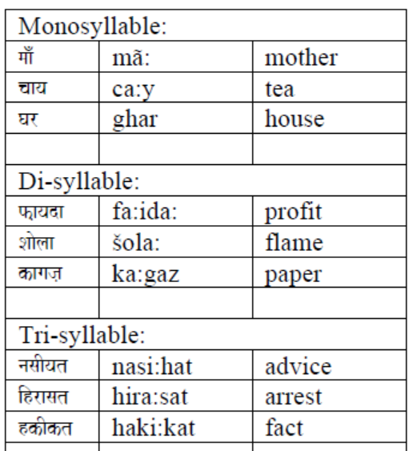
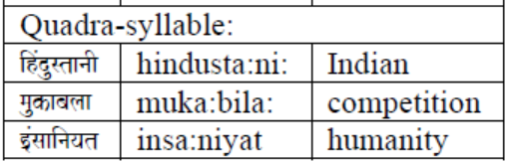
Types of syllables in Hindi

Slide 66
Phonotactic
It refers to permissible combination of sounds in a language
Eg. Consonant + Vowel (monophthong or diphthong),
Consonant + Consonant

Slide 67
Phonotactic in English
English is a language permitting consonant cluster in word initial position as well as word final position
Eg.
blue /bluː/ clear /klɪə/
try /trai/ cry /kraɪ/
play /plei/ pry /prei/
spray - /spreɪ/ sky /skʌɪ/
text /tekst/ texts /teksts/
trend - /trend/

Slide 68
English is a language permitting upto 3 consonant cluster in word initial position
Strength /strɛŋθ/
Split /splɪt/
Spray /spreɪ/
Strive /strʌɪv/
Strong /strɒŋ/
Straw /strɔː/
Splash /splaʃ/
Strike /strʌɪk/
Scrub /skrʌb/
Stress /strɛs/
The rule is: S_ Stop sound_ Liquid sound
VL Fricative S _ (voiceless Stop) p t k _ (liquid) l r

Slide 69
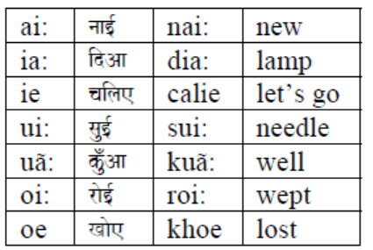
Phonotactic in Hindi
Vowel Sequences
In Hindi only two vowel sequences are permissible.

Slide 70
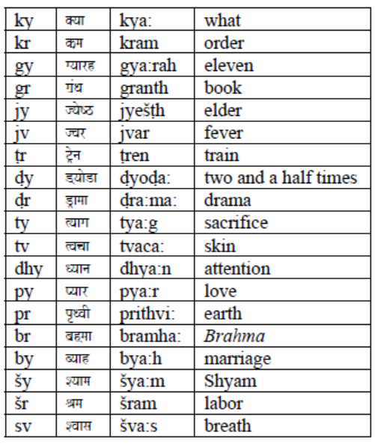
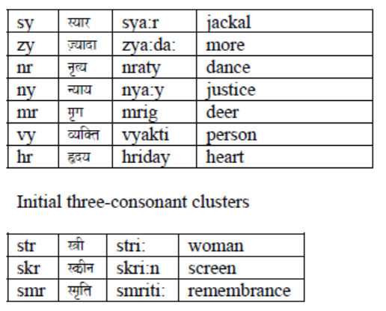
Consonant Clusters: Word-initial Consonant Clusters
Word-initial consonant clusters are not as frequent as the word-medial consonant clusters.

Slide 71
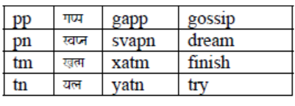
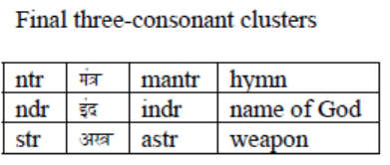
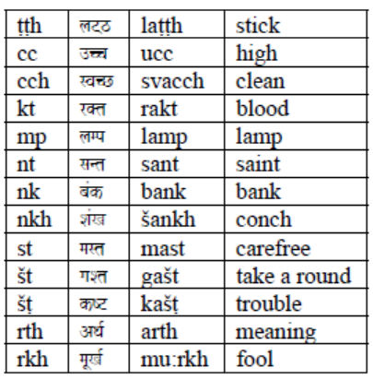
Word-final Consonant Clusters
Consonant clusters occur less frequently in the word-final position.

Slide 72
To conclude the phonemic inventory typology, we can say that:
Every spoken language has speech sounds: consonants and vowels.
The number of speech sounds or segmental phonemes varies from language to language.
Most languages have between 20 and 45 phonemes.
Some segmental phonemes are universal, while others are found in some languages and not in others.
All spoken languages have phonological rules

Slide 73
The syllable structure of languages also varies.
Different language exhibit phonotactic constraints:
Some languages allow combination of certain consonants (called consonant clusters) in the word initial
and final positions. While certain combination of consonants are not permitted in languages.
Eg. English allow combination of consonants like Str, Spr, Spl, in the word initial position.
combination of consonants like kst in /tekst/, ksts in /teksts/, and nd in /trend/
So also, Hindi has its own phonotactic constrains (see previous slides on Hindi phonotactic)

Slide 74
References
Koul, Omkar N. (2008). Modern Hindi Grammar. Dunwoody Press
Gordon, Matthew K. (2016). Phonological Typology. Oxford University Press.
Yule, George (2020). The Study of Language. Seventh Edition. Cambridge University
Press.
https://ielp.ehe.osu.edu/files/2022/08/Hindi_IPA.pdf

Slide 75
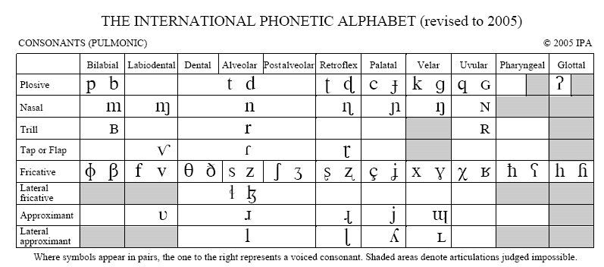
Limits to elaboration (pulmonic consonants)
IPA Chart, http://www.internationalphoneticassociation.org/content/ipa-chart, available under a Creative Commons Attribution-Sharealike 3.0 Unported License. Copyright © 2005 International Phonetic Association.

Slide 76
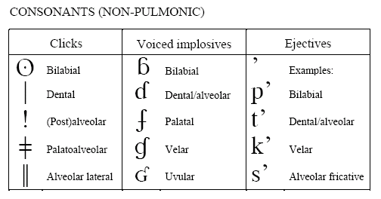
Limits to elaboration (non-pulmonic and vowels)

Slide 77
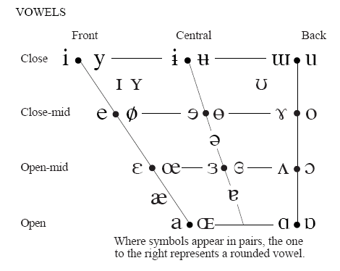
Limits to elaboration (non-pulmonic and vowels)
IPA Chart, http://www.internationalphoneticassociation.org/content/ipa-chart, available under a Creative Commons Attribution-Sharealike 3.0 Unported License. Copyright © 2005 International Phonetic Association.

Slide 78

The place of articulation
Articulators are part of organs involved in the production of human speech sounds.

